Slide 1
Sensor2Light
Ivan Boyd
November 1, 2021

Slide 2
Many Converging Interests
My Art
Spiritual Practice (Buddhist)
Conceptual Art (Kosuth)
Electronic Art (e.g., Kusama, McElheny, Meow Wolf)
Integration of life experiences (The Sublime)
Spirit Sensing (Right, it’s def pseudo-science, and it’s a fun idea)

Slide 3
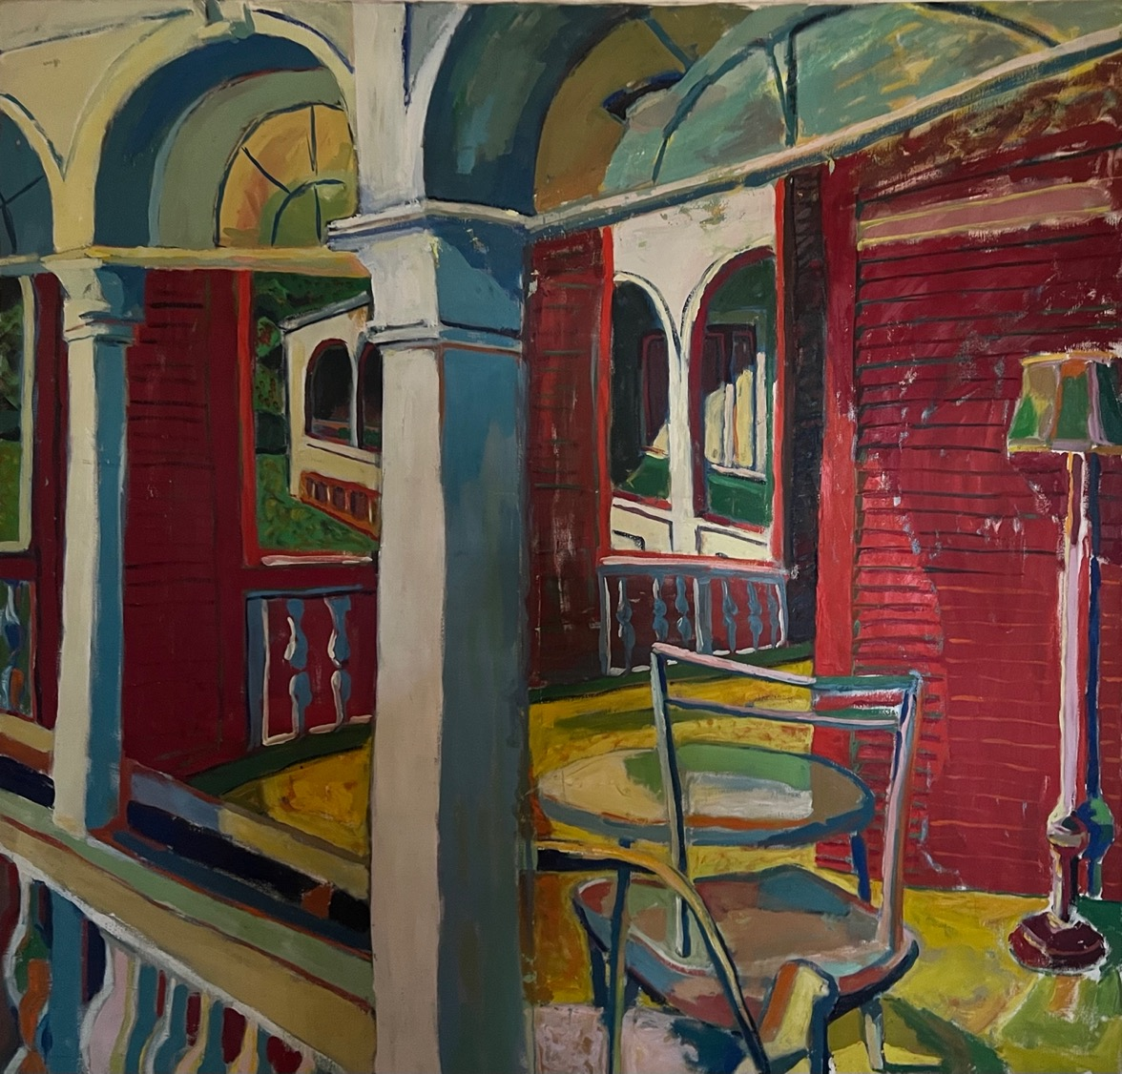
Norfolk Lawn,
Oil, 54” x x54”
1977
Notes:
Post impressionism, expressionism, fauvism.
Looking back, a feeling of presence

Slide 4
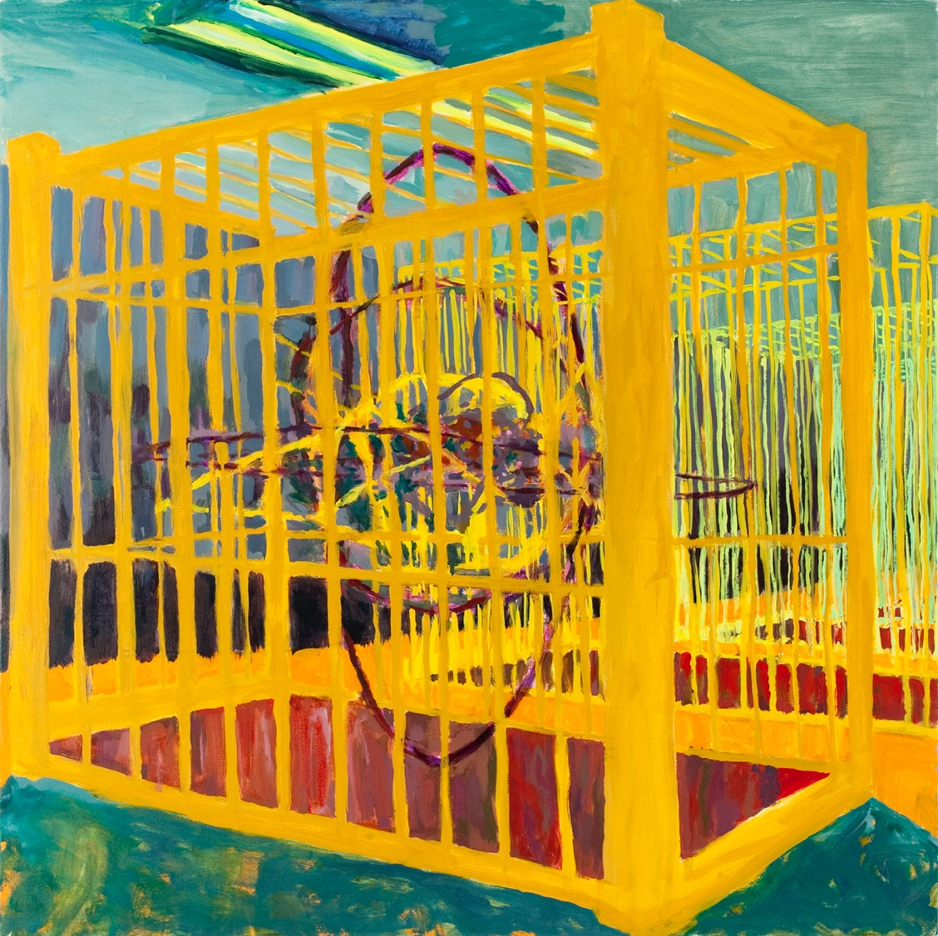
Caged
Oil, 72” x 72”
2009

Slide 5
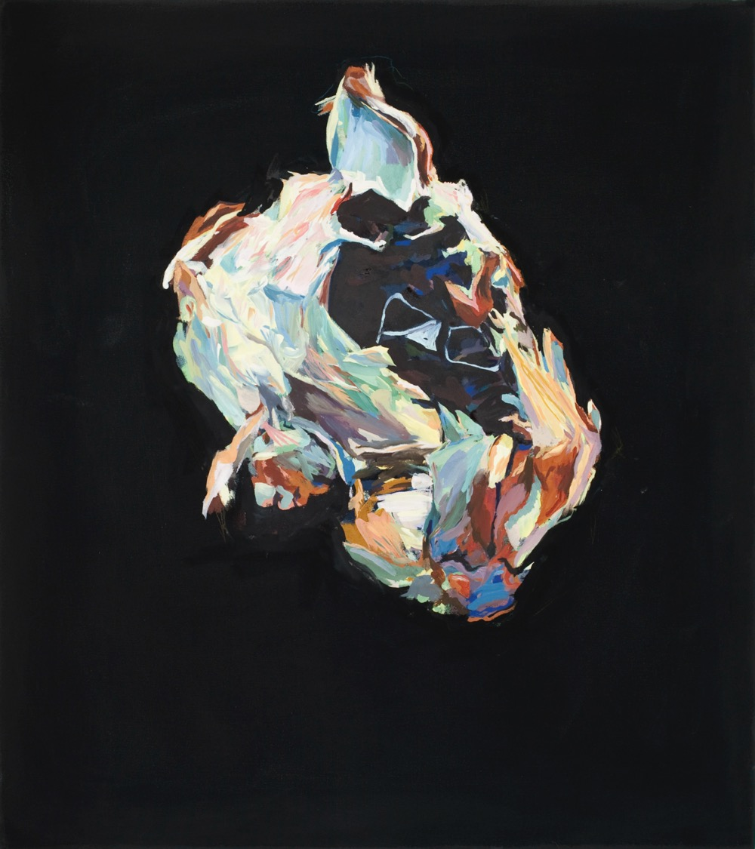
Wooly Rock
Oil, 24” x 30”
2011
Notes:
Strange presence, unknowable entity, familiar but not of this world
Painterly, can see brushwork, etc. evidence of my hand making it

Slide 6
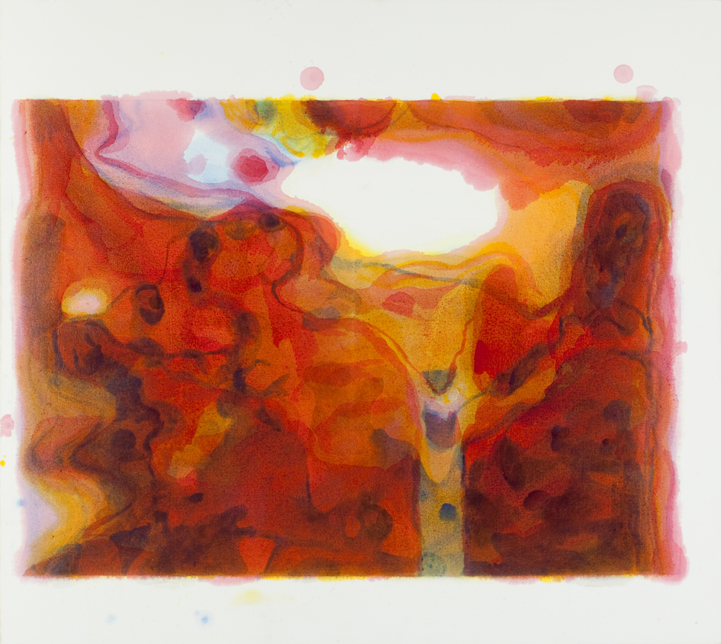
Zombie Wedding Party
Oil, 50” x 64”
2012
Notes:
Based on digital separation of an image of a wedding dance. 4 colors, imitates the CMYK printing process color scheme, ~50 layers of glaze, playful interest in spirit, deconstruction
Decentered
Virtually no painterliness, so to speak
Evidence of accident and randomness

Slide 7
Ocean,
Digital giclee, 12” x 12”
2015
Notes:
Giclee – archival / museum quality inks and papers. Will last hundreds of years if stored properly without any degradation
Digital art imitating photography imitating printmaking
Massed gesture

Slide 8
Ocean,
Digital giclee, 12” x 12”
2015
Notes:
Gestural mark making
Massed gesture

Slide 9
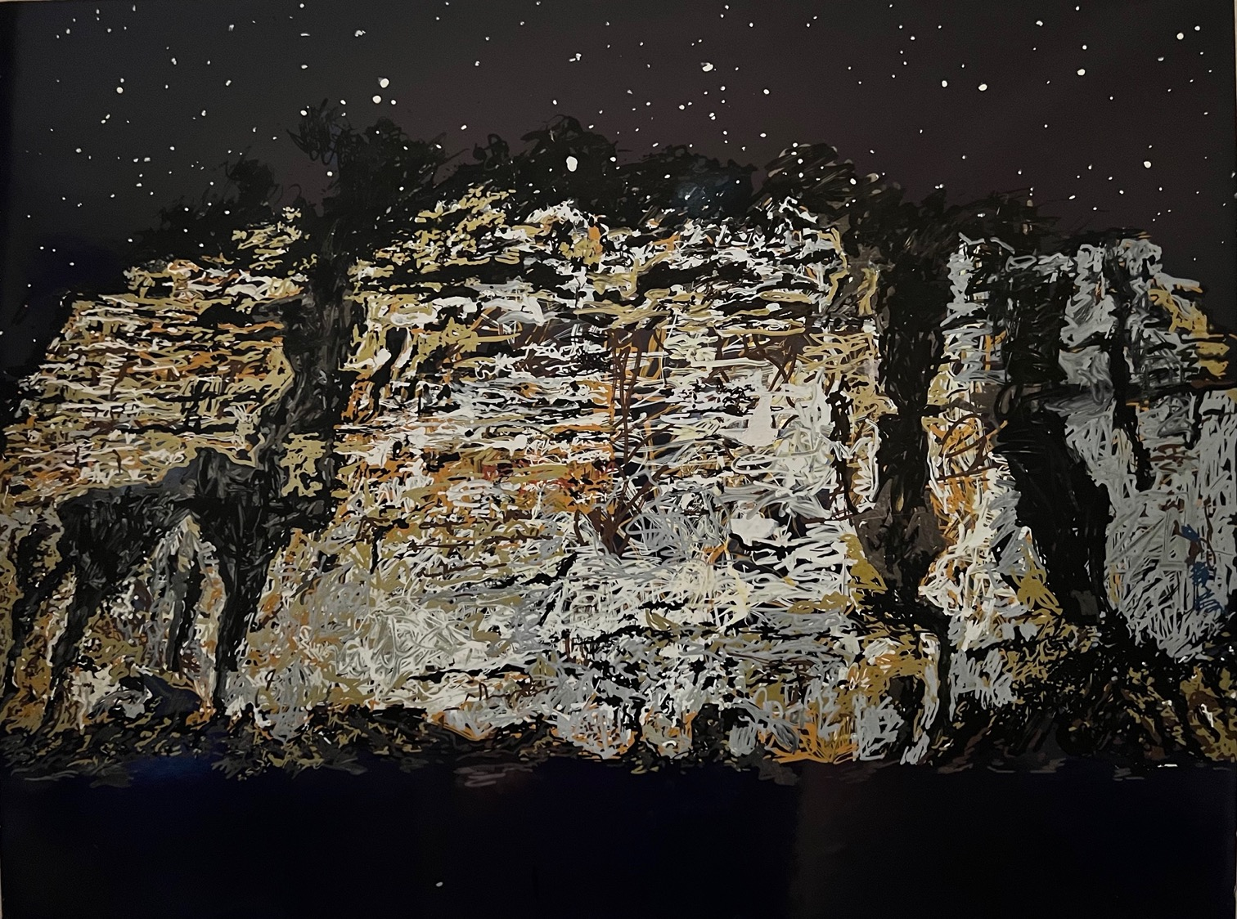
Ojo Caliente,
Acrylic, 20” x 28”
2018
Notes:
Ojo Caliente, painted star positions from astrological time and date image
Massed gesture

Slide 10
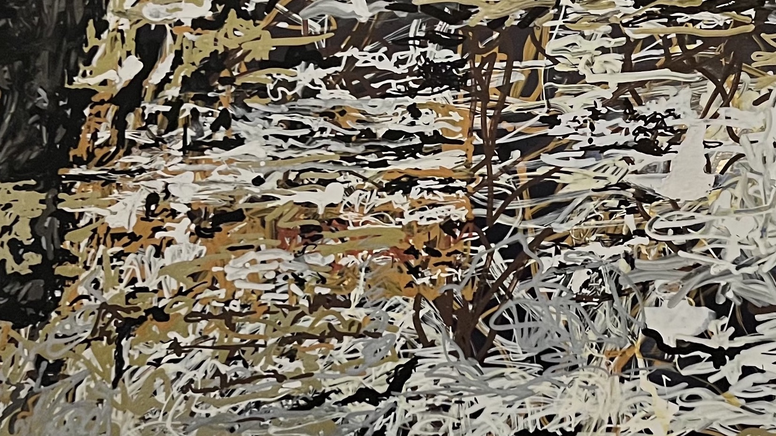
Ojo Caliente,
Acrylic, 20” x 28”
2018
Notes:
Ojo Caliente, painted star positions from astrological time and date image
Massed gesture

Slide 11
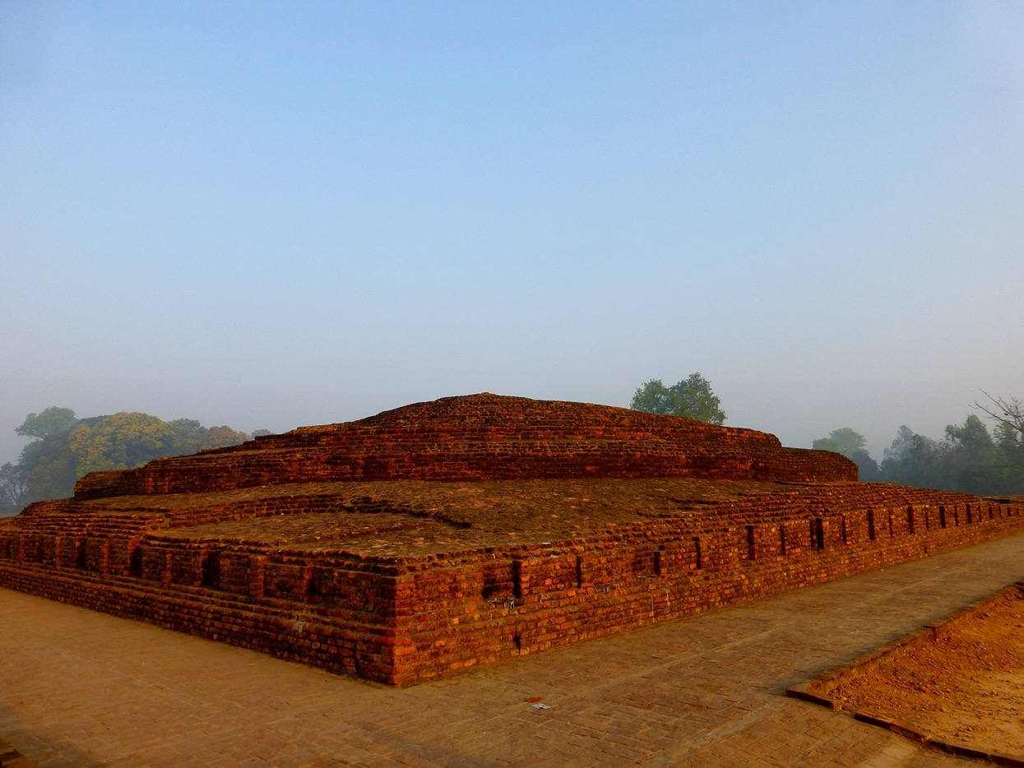
Earliest Known Buddhist Stupa
~ 250 - 480 BCE
Buddha died 480 BCE
The Buddha had asked that he be buried under the earth "heaped up as rice is heaped in an alms bowl.”
Notes:
Stupa: “Heap” A religious architectural or smaller structure for
Built in 3 phases
around the time of the death of the Buddha, it was raised by piling up natural earth from the surrounding area. This was in accordance with a request of the Buddha who had asked that he be buried under the earth "heaped up as rice is heaped in an alms bowl."^{[20]}Phase II occurred during Ashoka’s rule (and was likely completed after his death around 235 BCE) as part of the Emperor’s mission to "distribute the relics of the exalted one."^{[21]} Ashoka opened up the original stupas containing the relics of the Buddha, then restored the stupa and interred a portion of what he had taken.

Slide 12
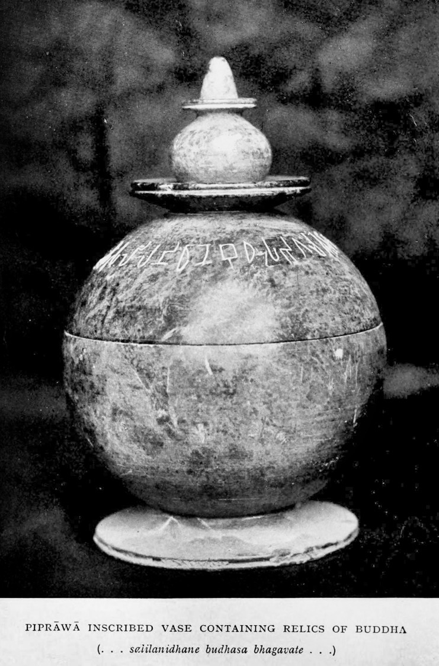
"these are the relics of the Buddha, the Lord"
Notes:
inscription as "these are the relics of the Buddha, the Lord"

Slide 13
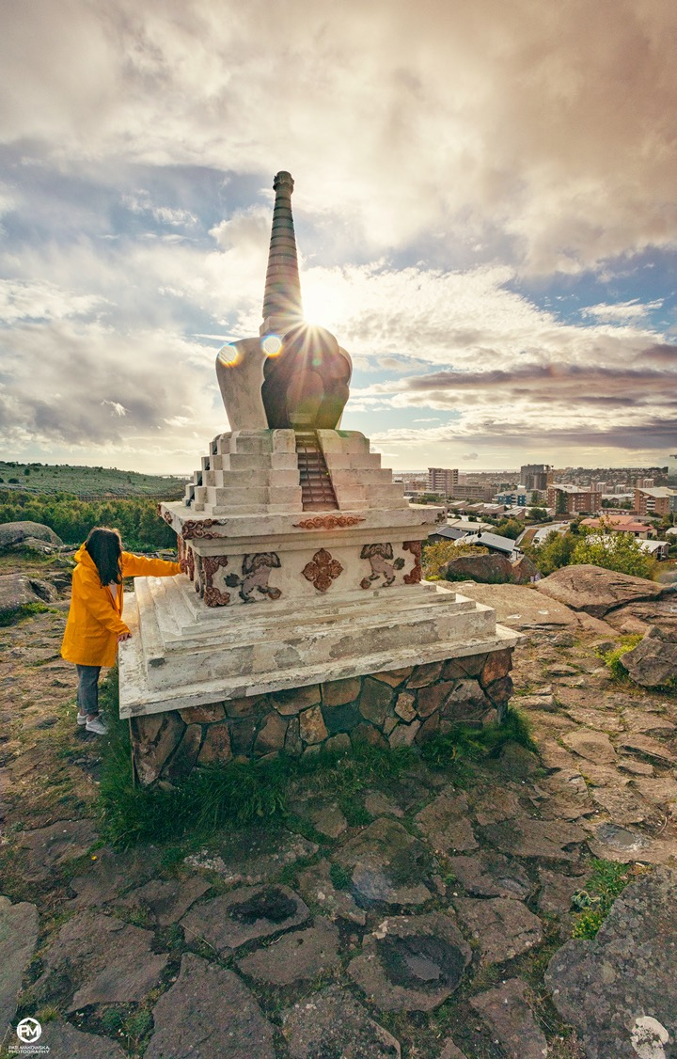
Tusita Stupa
2019
Kópavogur, Iceland
Notes:
Kópavogur, Iceland ***Buddhist Stupa 'Descent from Tushita Heaven' Iceland’19 The Buddha’s mother, Mayadevi, was reborn in Tuṣita Heaven. In order to repay her kindness the Buddha went there to teach the dharma to her. This stupa commemorates the Buddha’s return from this celestial realm in order to continue his teachings on earth.

Slide 14
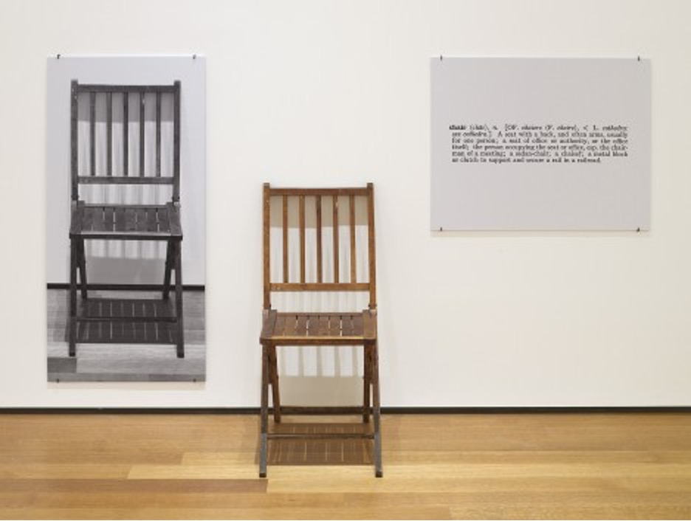
Conceptual Art
MOMA Museum
Joseph Kosuth
One and Three Chairs
1965
Wood folding chair, mounted photograph of a chair, and mounted photographic enlargement of the dictionary definition of "chair", Chair 32 3/8 x 14 7/8 x 20 7/8" (82 x 37.8 x 53 cm), photographic panel 36 x 24 1/8" (91.5 x 61.1 cm), text panel 24 x 30" (61 x 76.2 cm)
Notes:
In One and Three Chairs, Joseph Kosuth represents one chair three ways: as a manufactured chair, as a photograph, and as a copy of a dictionary entry for the word “chair.” The installation is thus composed of an object, an image, and words.
Kosuth didn’t make the chair, take the photograph, or write the definition; he selected and assembled them together. But is this art? And which representation of the chair is most “accurate”? These open-ended questions are exactly what Kosuth wanted us to think about when he said that “art is making meaning.” By assembling these three alternative representations, Kosuth turns a simple wooden chair into an object of debate and even consternation, a platform for exploring new meanings .
Epistemology of knowledge: Epistemology is the branch of philosophy that studies knowledge or knowing.It is the knowledge to examine reality.
Like in Zombie Wedding Party, playing with what does it mean to be a painting.

Slide 15

Mora, New Mexico
September, 2021
Notes:
Conceptual Art, capture the idea…. The sublime experience of the universe. I didn’t feel painting was up to the task.
Sublime: Awesome beauty + terror

Slide 16
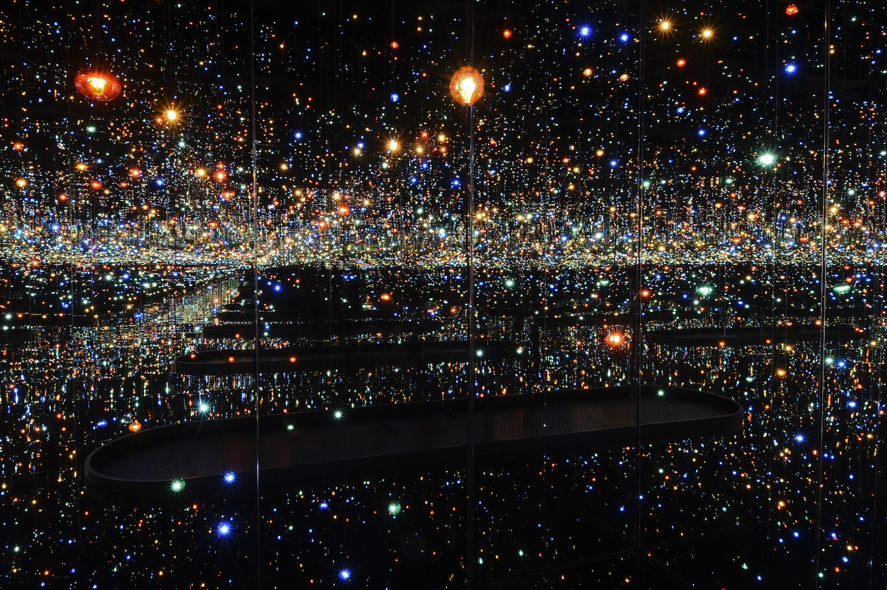
Yayoi Kusama
Infinity Mirrored Room
2013
Souls of Millions of Light years away
The Broad Museum, Los Angeles
Notes:
The Broad Museum, Los Angeles

Slide 17
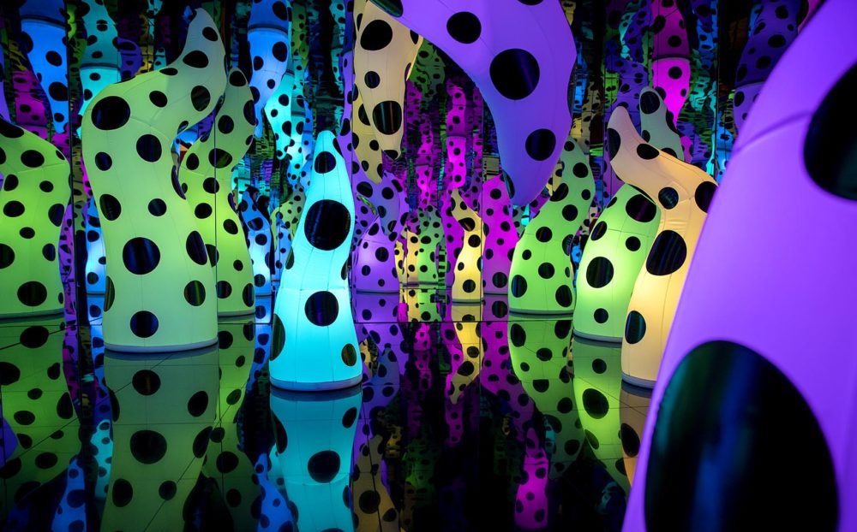
Notes:
Yayoi Kusama, Love is calling

Slide 18
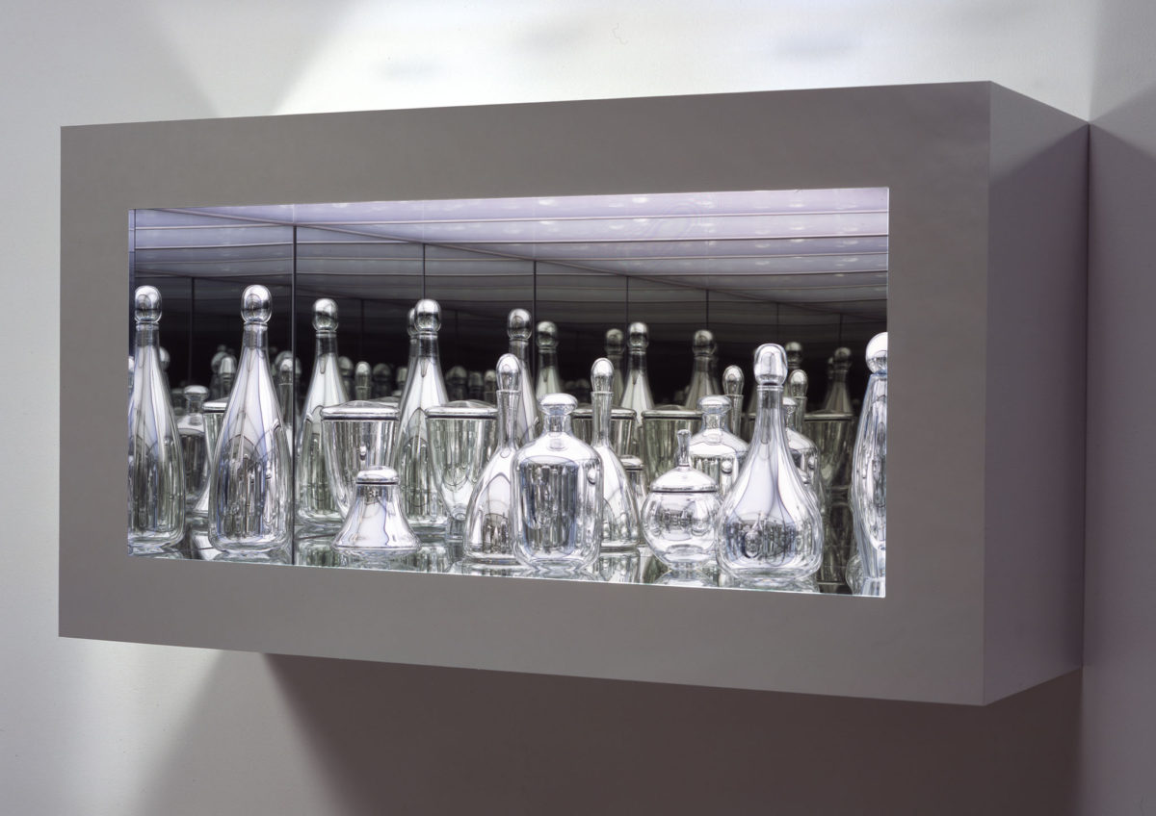
Josiah McElheny
Modernity circa 1952, Mirrored and Reflected Infinitely
2004
Hand-blown mirrored glass objects, chrome metal display, glass and mirror

Slide 19
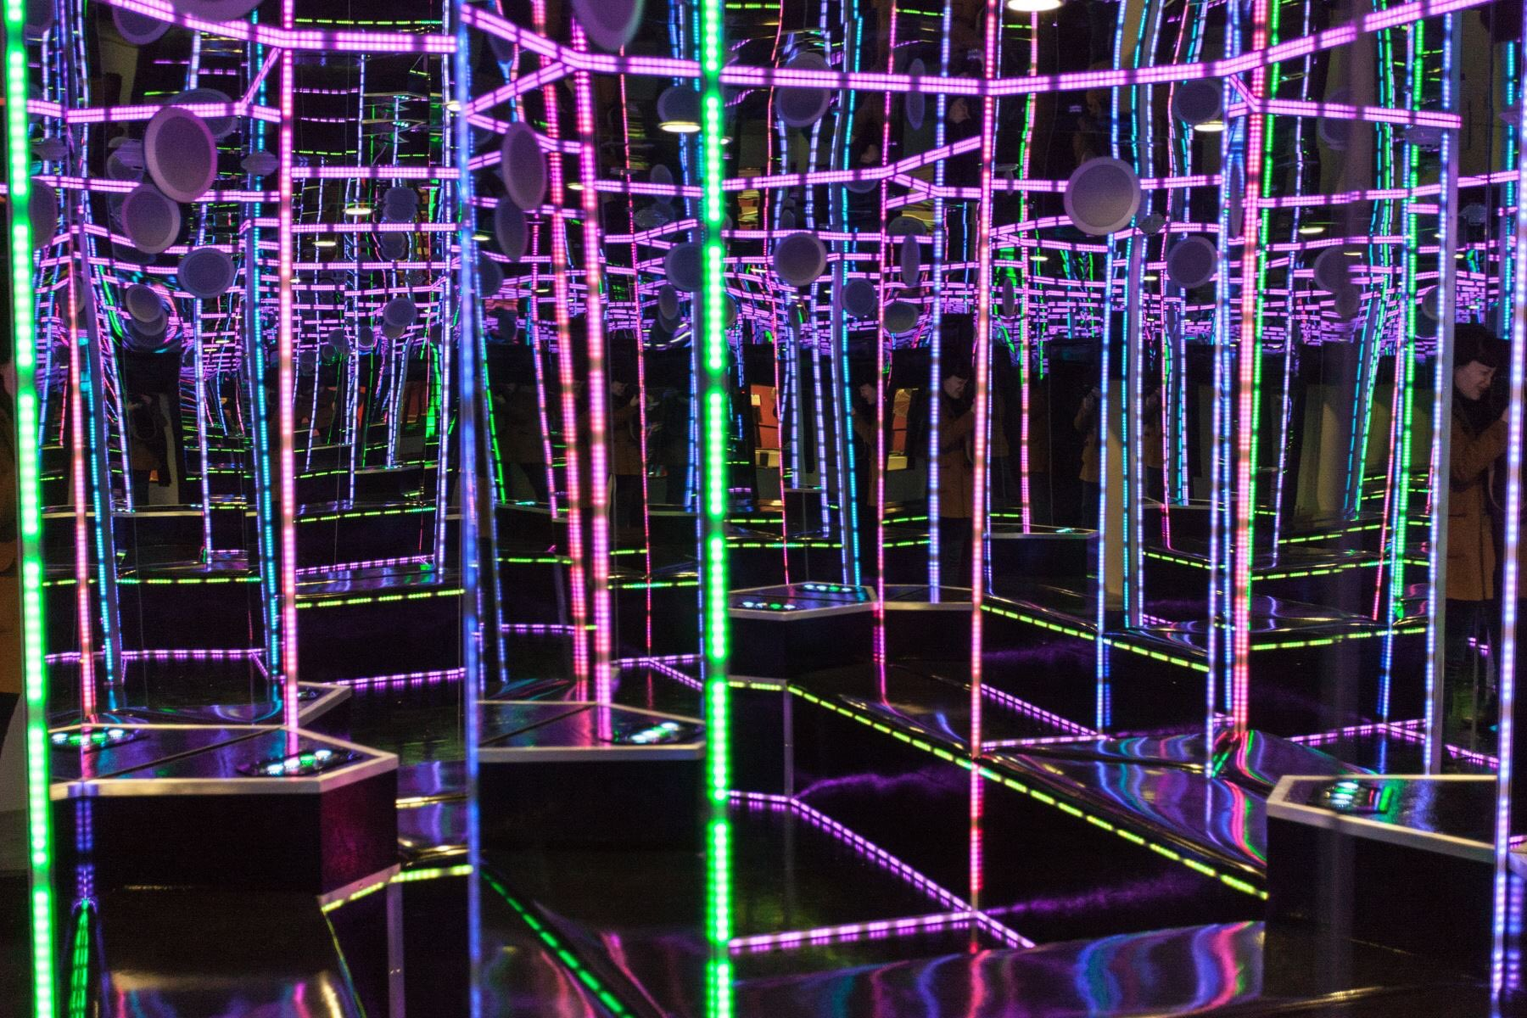
Notes:
Meow Wolf, Infinity Spa, 2017

Slide 20
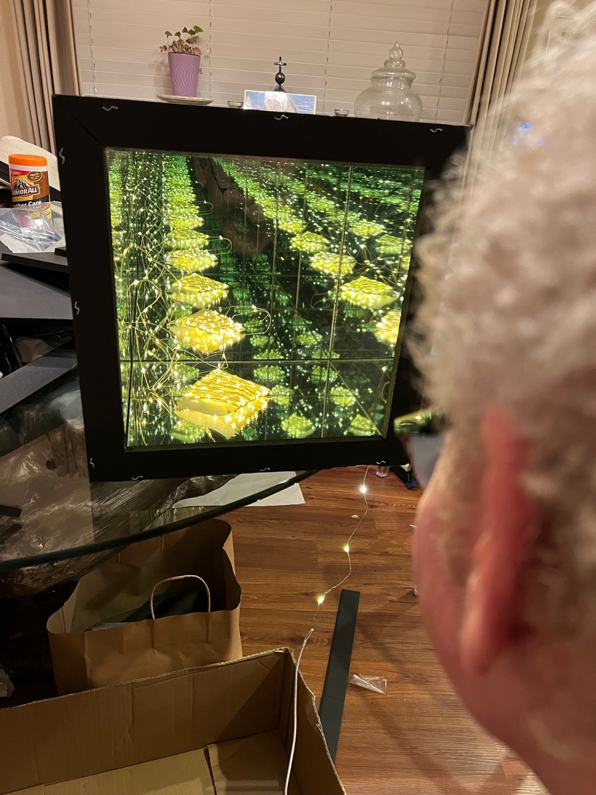
My first infinity box
September, 2021

Slide 21
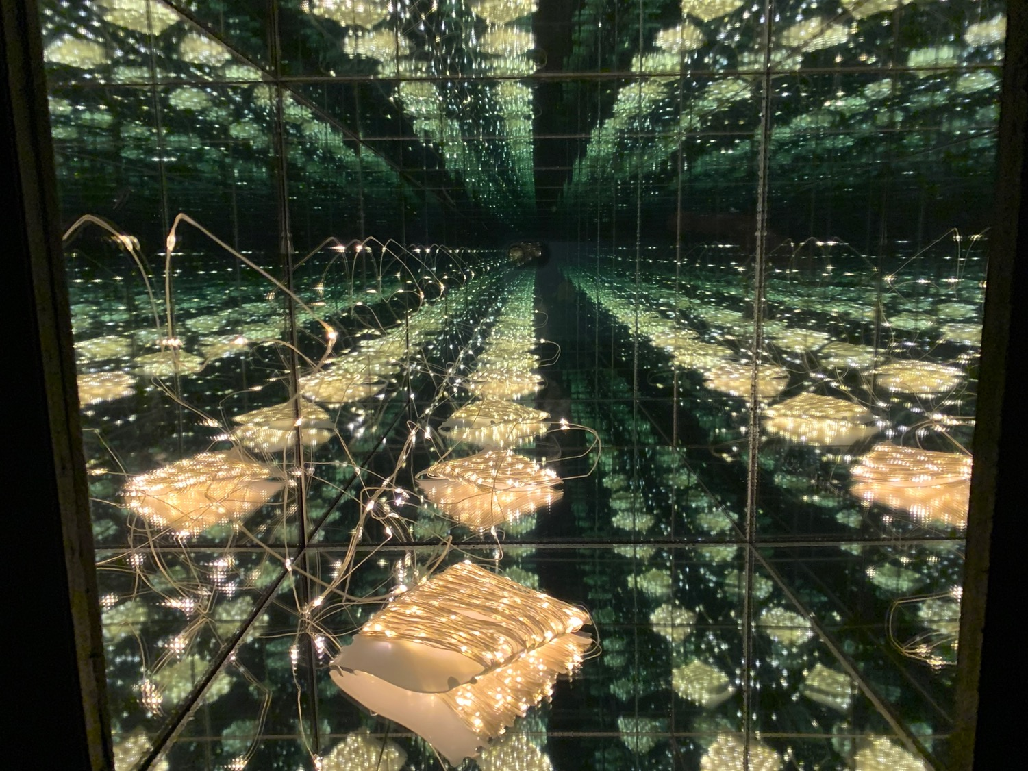

Slide 22
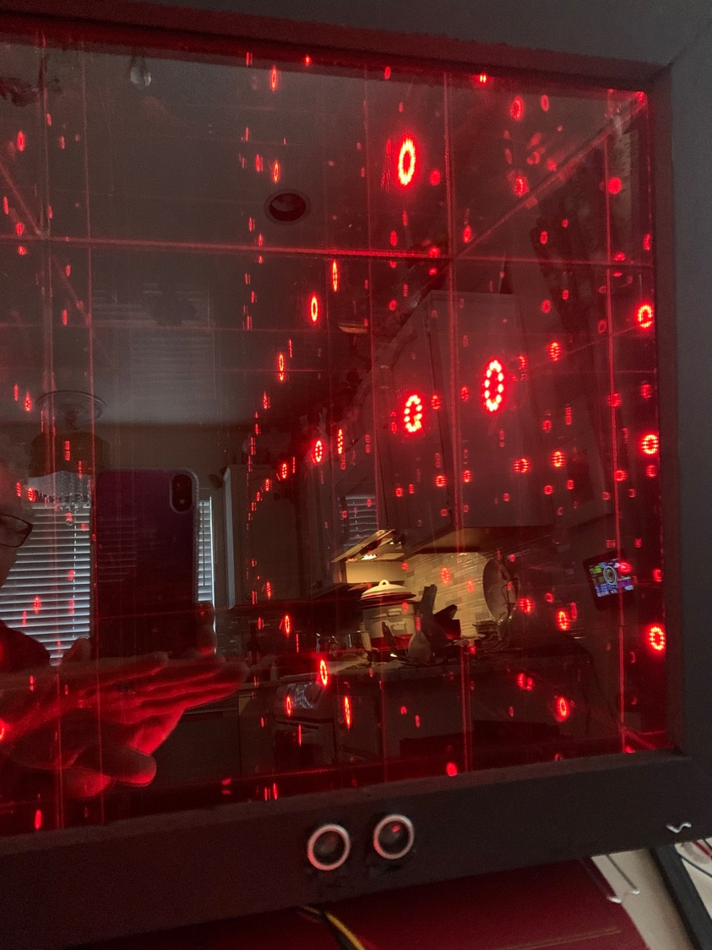
Sensor2Light
V0.1
An immersive electronic artwork that modifies a static infinity box with various forms of digital technology to create a dynamically interactive experience.
Long-range goal: To create an experience of the sublime.
Short-range goals: Create numerous unexpected, multi-sensory and surprising reactions inside and outside the infinity box to external presences.
Medium-range goal: Incorporate up-to-date spirit sensing technology and create additional multi-sensory reactions. I know, pseudo-science.
Notes:
Mirrors are reputed to have many properties that serve as a gateway, enabling and attracting communications with spirits.

Slide 23
Hardware
Teensy 3.2 Development Board
Adafruit BME280 temperature, pressure and humidity sensor
Adafruit SSD1306 OLED display
HC-SR04 distance sensor
Adafruit RGB and GRB Neopixels in chip, 5mm through hole and ring mounted
Basic LEDs and buttons
Ethernet, to attach network addressed WEMO and HUE light devices
Breadboard, misc 22 guage wires, resistors and capacitors
Lenovo LAPTOP-UFEV2AC3, 11th Gen Intel(R) Core(TM) i7-11800H @ 2.30GHz 2.30 GHz, 16GB Ram, 64-bit O/S, x64-based processor running Windows 10 Home

Slide 24
Software
Programming environment: Arduino's IDE software with the Teensyduino add-on Teensy.
C++
FormLabs
SolidWorks

Slide 25
Teamwork, Version Control, Social Media
Github
Slack
Microsoft Teams
Hackster
LinkedIn

Slide 26
User Settable Options
dBug = true, or dBug = false Setting this variable turns on several error messages to be printed to the 9600 bd Monitor. dBug can be set to “false” to significantly lessen noise on the 9600 bd Monitor
dBugDel (debug delay) sets the number of seconds that the program is slowed down by. When enabled, the program does not work correctly due to the accumulation of delay()’s that affect how distance is read and time is measured.
eNet = true, or eNet = false, If running without ethernet attached then set eNet to false. This will eliminate any ethernet attached devices, such as WEMO controlled outlets or HUE lights.
temperatureTrigger = 1, This is # of degrees over the 5 deg average required to trigger the ring Neopixel flicker reaction when touching the temperature sensor. Increase the number to number of degrees over average wanted to trigger the ring Neopixel flicker.

Slide 27
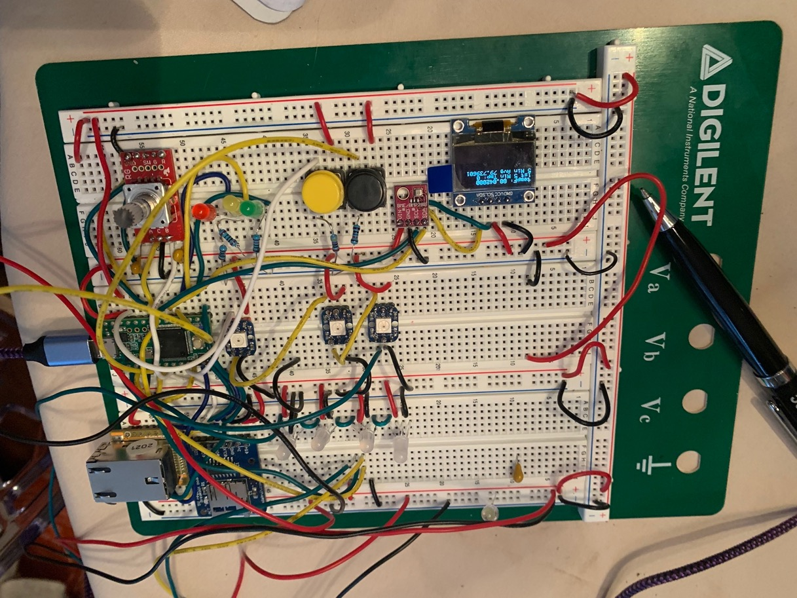
DEMONSTRATION

